Slide 1



Finolex Academy of Management and Technology
Topic : E-commerce Website using MERN Stack
Mini Project presentation submitted
in
partial fulfilment of the requirements for the degree
of
Bachelor of Engineering
in
Computer Science and Engineering (AI & ML)
food
Submitted By :
Rushikesh Amberkar RD-22-0373
Afan Fondu RD-22-0526
Raj Joshi RD-22-0374
Sahil Shivgan RD-22-0371
Guided By :
Prof. Mahesh Jadhav
Department of Computer Science and Engineering (AI & ML)
AUGUST, 2023

Slide 2
E-commerce Website using MERN Stack

Slide 3
Acknowledgement
We hereby sincerely acknowledge those who have dedicated their valuable time, energy, and intellect to the enhancement of our project titled "Ecommerce Website using MERN Stack."
It brings us immense pleasure to convey our sincere and heartfelt gratitude to our guide, Prof. Mahesh Jadhav, Department of Computer Science and Engineering (AIML), FAMT, Ratnagiri, for his keen interest, inspiring guidance, valuable advice, encouragement, and assistance throughout the project.
We are indebted to Prof. V. V. Nimbalkar (H.O.D), Department of Computer Science and Engineering (AIML), FAMT, Ratnagiri, for her unwavering encouragement and unparalleled support in bringing this project to fruition. Our gratitude also extends to other faculty members, non-teaching staff of the CSE Dept., who have directly and indirectly contributed to our project and have motivated us to present it in its current form.

Slide 4
Introduction
Welcome to our project presentation showcasing the creation of an E-commerce Website using the dynamic MERN Stack (MongoDB, Express.js, React, Node.js).
Our aim is to transform online shopping using modern tech. This presentation will show you how we've used the MERN Stack to create a better online retail experience.
Easy navigation, product discovery, and smooth transactions. Let's dive into the future of digital shopping, where technology connects businesses and customers like never before.

Slide 5
Problem Statement
The purpose of this project is to create a web application that simplifies the process of discovering appealing products / items and facilitates efficient sales transactions.
Within this E-commerce web application, the admin has the capability to introduce various categories of products. Customers themselves can effortlessly explore their preferred products and make purchases smoothly by adding items to their cart, with the option to adjust quantities using the "+" and "-" icons.
Following this, they can review the cumulative amount of the items in their cart. Additionally, a successful payment gateway is implemented to enable transactions via cards or
cash on delivery.

Slide 6
Architecture
High-Level Overview –
Our E-commerce website architecture leverages the MERN Stack – React for frontend, Node.js/Express.js for backend, and MongoDB for data storage. This combination ensures efficient communication and a cohesive user experience.
Components –
Frontend (Client): Built using React for user interface.
Backend (Server): Developed with Node.js and Express.js for handling requests.
Database: MongoDB stores product, user, and order data.
Communication –
Frontend → Backend: API requests for data and functionality.
Backend ↔ Database: Communication for data retrieval and storage.
Deployment –
Deployed and Hosted on cloud server i.e., Vercel.

Slide 7
Architecture contd.
Security –
Implement authentication and authorization mechanisms for secure user interactions.
Scalability –
Architecture designed to handle increased traffic and users effectively.
Technologies –
React for UI, Node.js/Express.js for server logic, MongoDB for data storage.
User Experience –
Ensure a consistent user experience across modules.

Slide 8
Objectives
The primary objective of this Ecommerce Website is to establish a robust online platform for buying and selling products. This website is built with the aim of modernizing and streamlining the traditional brick-and-mortar shopping experience. The project will achieve the following objectives:
To manage a comprehensive database of products available for sale.
To enable effortless product updates and additions by administrators.
To offer a secure and streamlined checkout process for customers.
To integrate payment gateways ensuring safe and efficient transactions.
To provide search and filtering options for easy product exploration.
To allow customers to leave feedback and ratings for products

Slide 9
Hardware and Software Requirements
Hardware Requirements
Software Requirements
Processor : Dual-core (2.5 GHz).
RAM : Minimum 4GB (8GB or more recommended).
Storage : Minimum 1GB free space.
Network : Stable internet connection.
Operating System : Windows 10 or higher.
IDE : Visual Studio Code.
Node.js : Version 18.1 or higher.
MongoDB : Install locally or use MongoDB Atlas (cloud service).
Browser : Chrome (Latest version).

Slide 10
Methodology
Step 1: Defined Project Scope
Defined the scope, objectives, and requirements for the project.
Established a clear understanding of the project's goals.
Step 2: Chose Technology Stack
Evaluated options and selected the MERN Stack (MongoDB, Express, React, Node.js) for development.
Step 3: Designed Database and UI/UX
Designed a scalable and efficient database schema for product catalog and user data.
Created responsive user interfaces to ensure a smooth user experience.
Step 4: Developed APIs and Authentication
Developed RESTful APIs using Node.js and Express for data manipulation.
Implemented user authentication to ensure secure access.

Slide 11
Methodology contd.
Step 5: Integrated Third-Party Services
Integrated payment gateway and shipping APIs for smooth transactions.
Handled API documentation and response handling.
Step 6: Added Real-Time Features and Testing
Implemented real-time cart updates using WebSocket's to enhance user experience.
Conducted comprehensive testing, including unit, integration, and user acceptance testing.
Step 7: Deployment and Documentation
Deployed the application to a cloud hosting provider.
Maintained clear and organized documentation for codebase and configurations.
Step 8: User Feedback and Improvements
Engaged users for testing and gathered valuable feedback.
Made necessary improvements based on user feedback.
Step 9: Website Launch and Ongoing Support
Launched the website to the public and ensured accessibility.
Provided continuous support and monitored for issues.

Slide 12
Work Flow Diagram for Customer
Start
Register / Login
Stop
Search Product
Collect Payment
Receipt
Apply Filter
Ship Product
Choose Product
Place Order
Add to Cart
Yes
Buy?
No
Continue Shopping

Slide 13
Work Flow Diagram for Admin
Start
Register / Login
Add Category
Stop
Add Products
Manage Orders
Manage Payment
Logout
Check Feedback
Reports

Slide 14
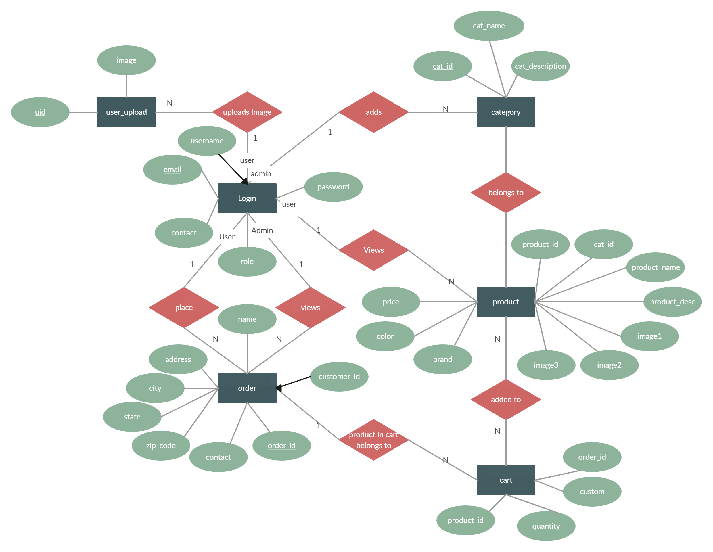
E-R Diagram

Slide 15
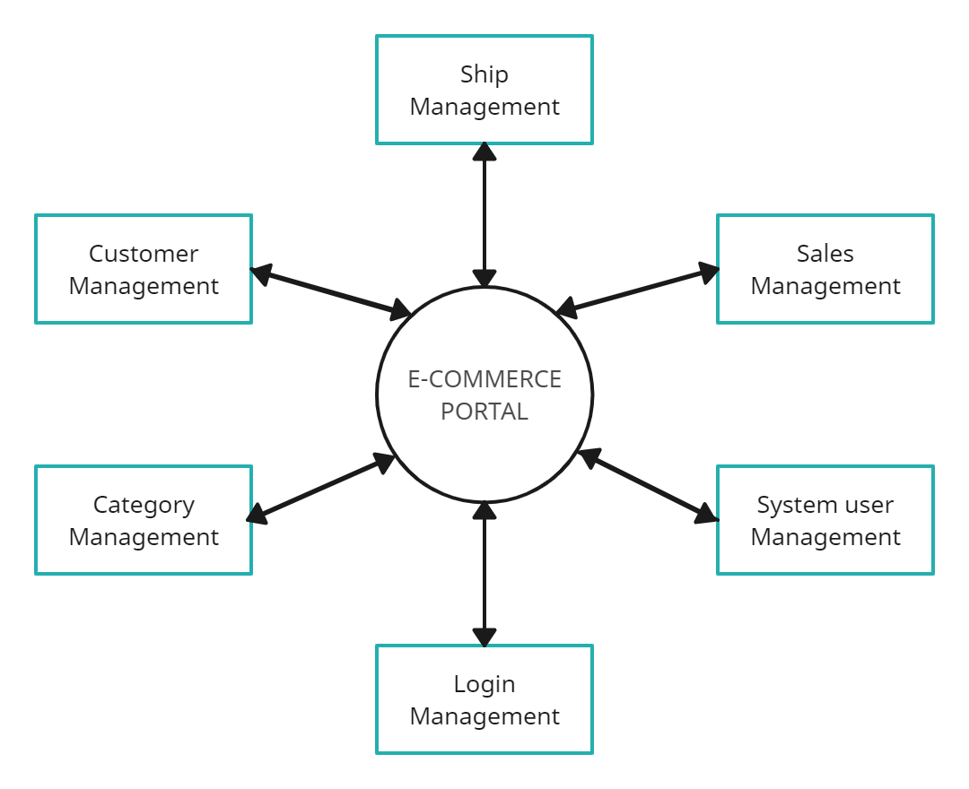
DFD Diagram

Slide 16







Packages Used
React
Express
Mongo DB
Node Js
Node Mailer
Stripe Payment Integration
Vercel

Slide 17
Challenges Faced
There were various technical challenges faced by us while developing this web application. Some major of them are listed below:
Database Design and Modeling: Designing an efficient and scalable database schema that meets the requirements of an Ecommerce platform was complex.
Front-End User Experience: Designing an intuitive and responsive user interface that provides a seamless shopping experience required careful consideration of design principles.
Real-Time Updates: Implementing real-time updates for user carts and order statuses required understanding WebSocket's and managing real-time data flow.
Testing and Debugging: Identifying and resolving bugs across the entire stack, from front-end to back-end, while maintaining a consistent user experience was time-consuming.
Version Control and Collaboration: Coordinating the work of a development team using version control systems and resolving merge conflicts were ongoing challenges.

Slide 18
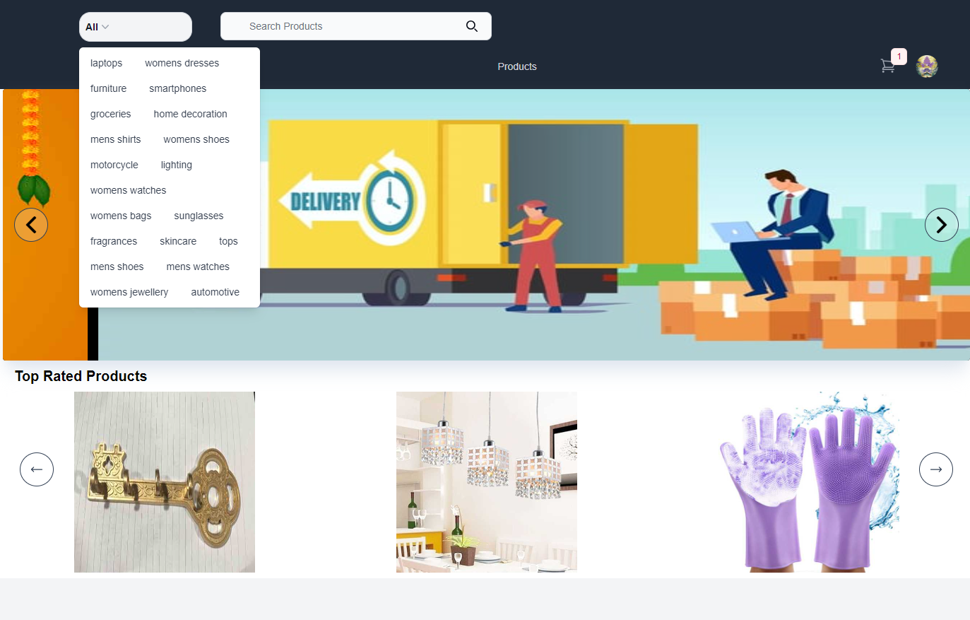
Key Feature For End User
1. Searching Product From Home Page

Slide 19
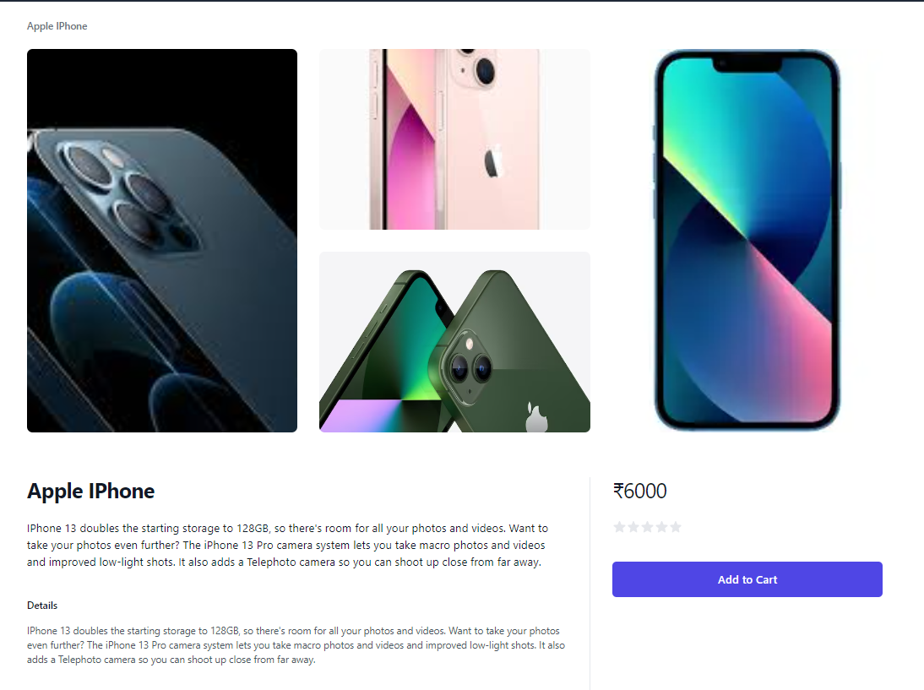
Key Feature For End User
2. Product Details

Slide 20
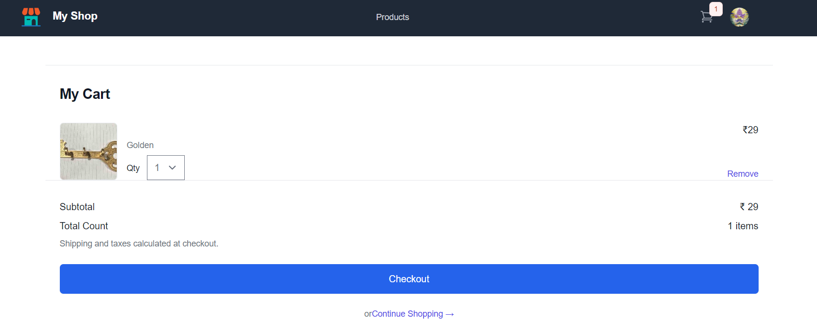
Key Feature For End User
3. Cart

Slide 21

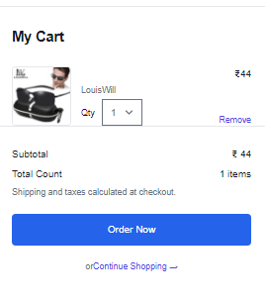
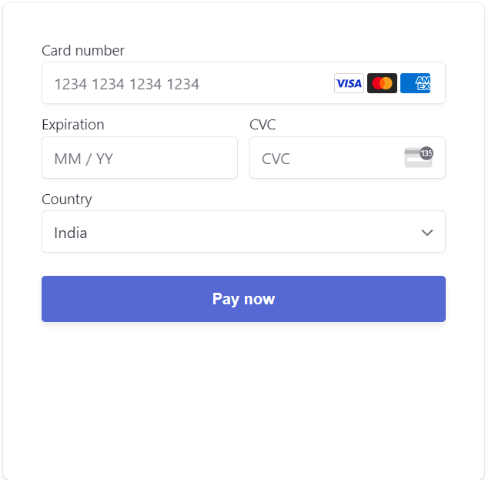
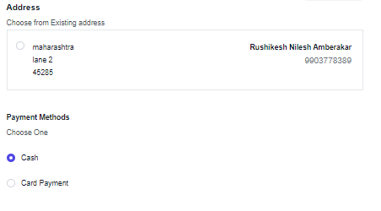
Key Feature For End User
4. Card Payment

Slide 22
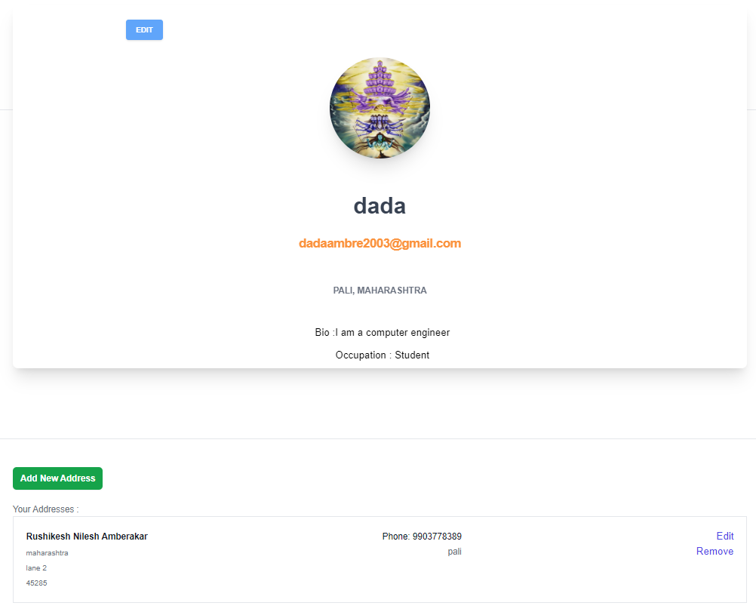
Key Feature For End User
5. User Profile

Slide 23
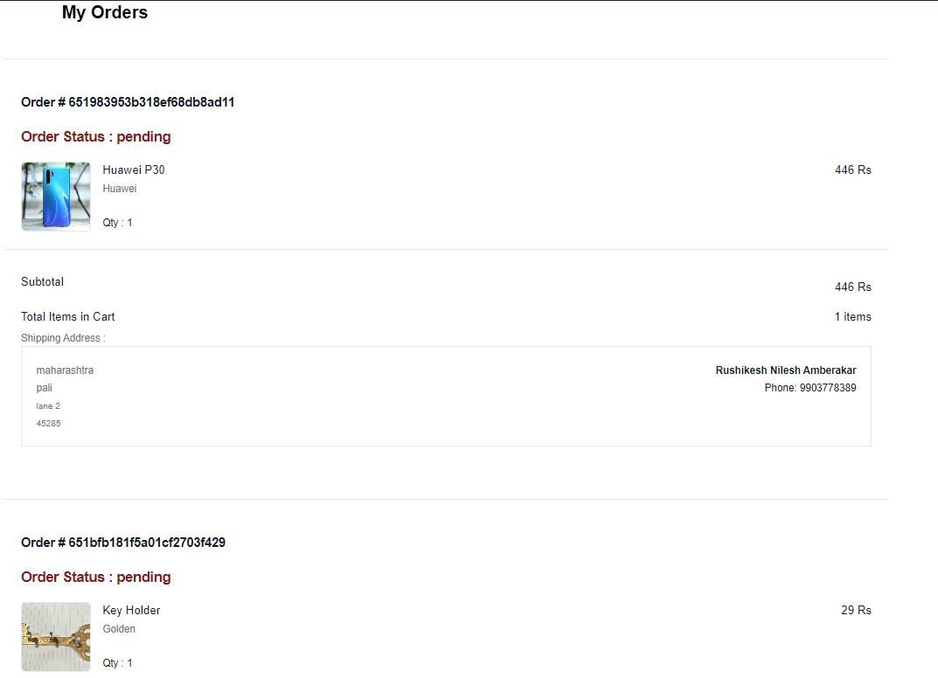
Key Feature For End User
6. My Orders

Slide 24

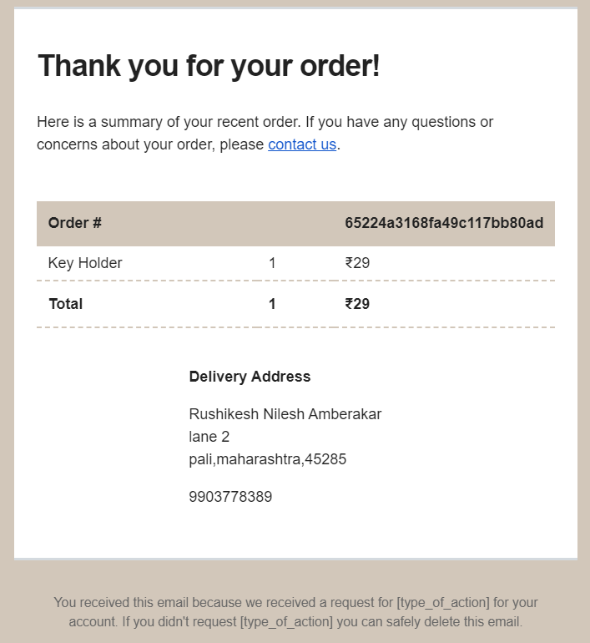
Key Feature For End User
7. User Get Bill & Purchased Notification At Mail

Slide 25
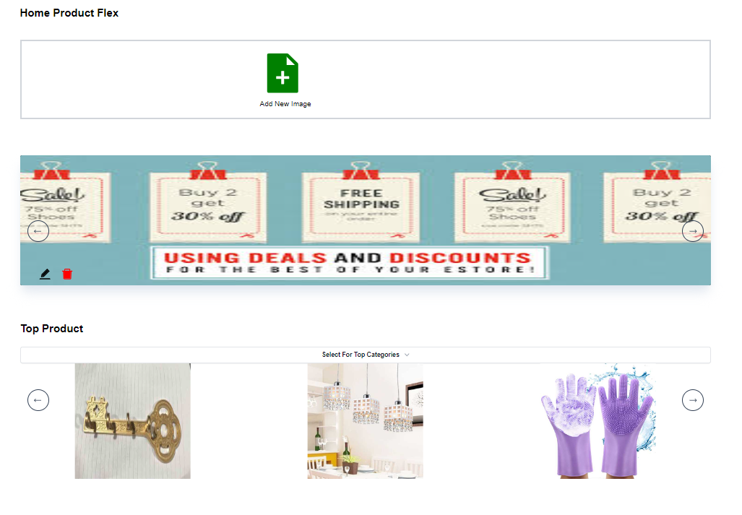
Key Feature For Admin
1. Admin Panel To Handle Home Page of E-commerce

Slide 26
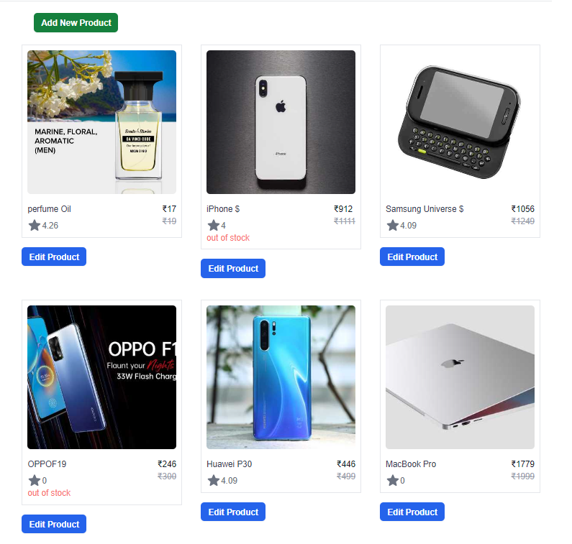
Key Feature For Admin
2. Admin Create New Product & Remove

Slide 27
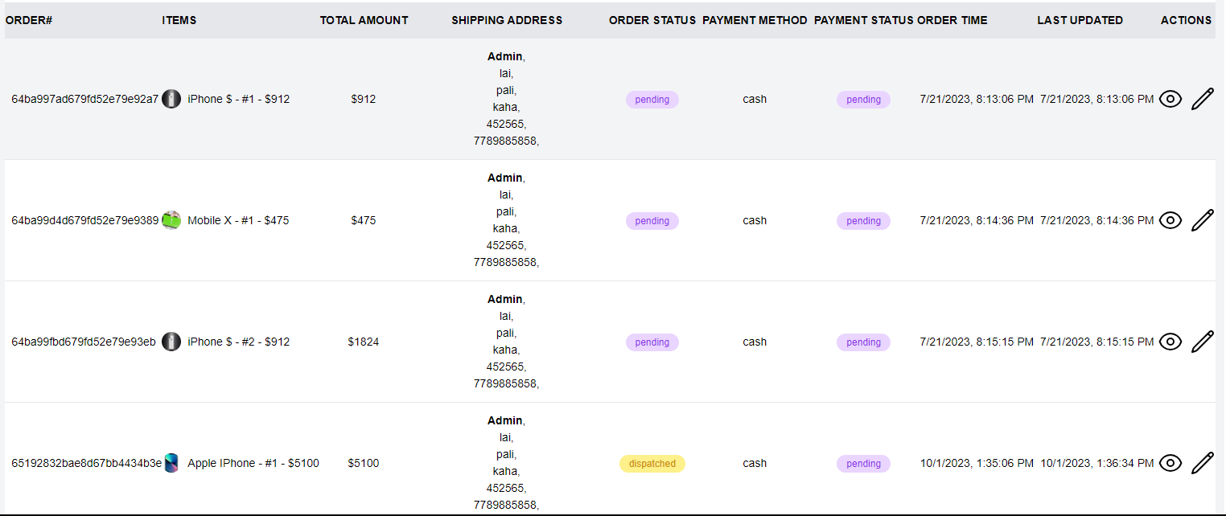
Key Feature For Admin
3. Admin View For Customer Orders

Slide 28
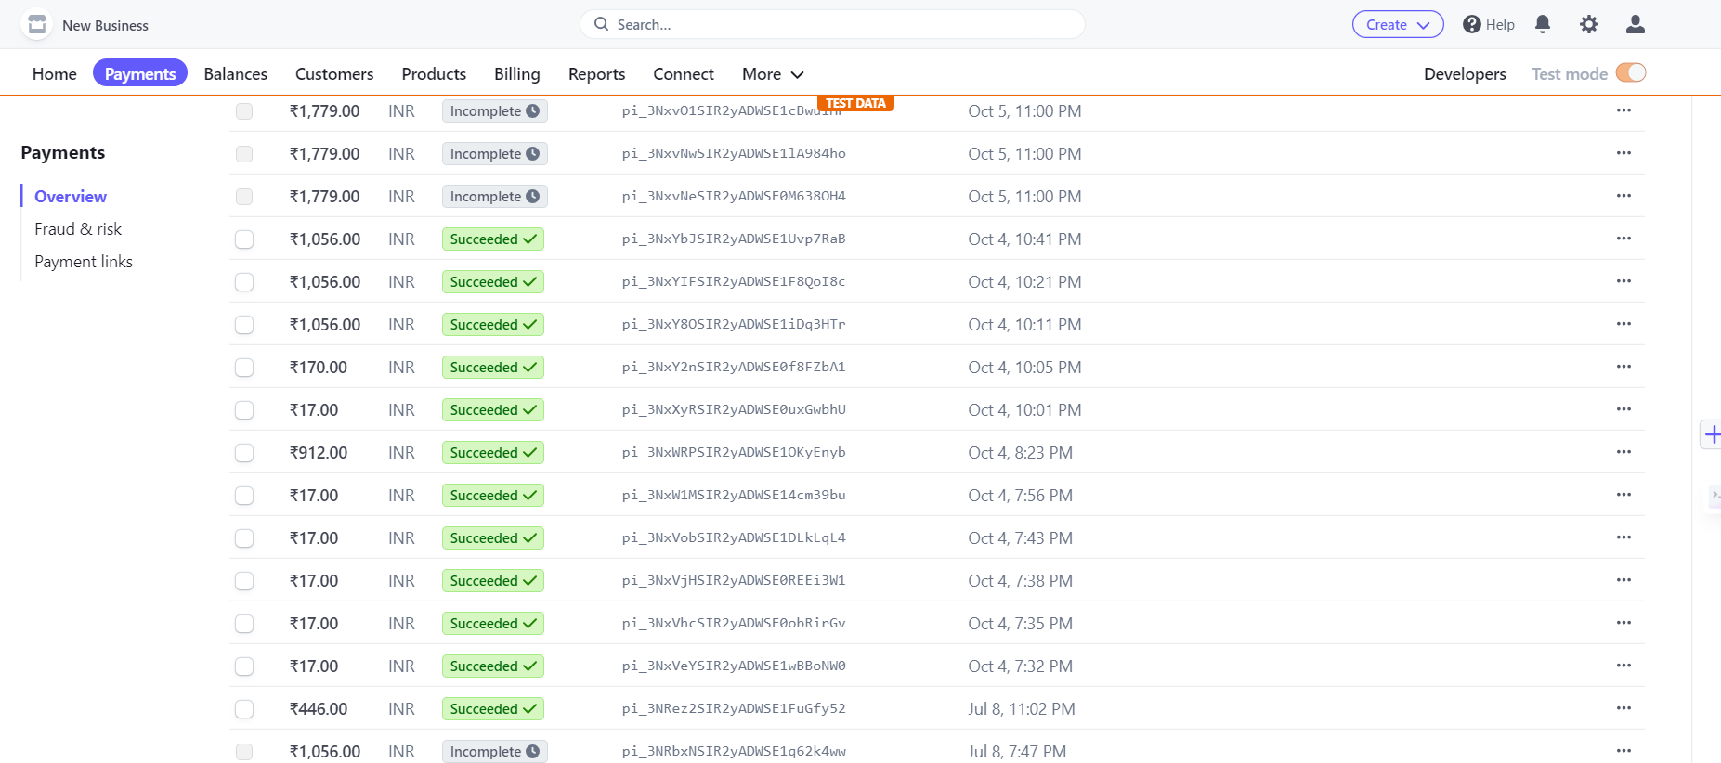
Key Feature For Admin
4. Stripe Payment System Dashboard

Slide 29
Future Scope
In the future, we envision enhancing the user experience and expanding the functionalities of the e-commerce website. Some of the potential areas for future development include:
User Profiles: Implementing user profiles that allow customers to save their favorite products, track their order history, and receive personalized recommendations based on their preferences.
Advanced Search and Filters: Introducing advanced search options and filters to help users quickly find their desired products, such as filtering by size, color, price range, and more.
Wishlist: Adding a wishlist feature that allows users to save products they're interested in for future purchase, promoting engagement and retention.
Multiple Payment Options: Incorporating a variety of secure payment options, including digital wallets and payment gateways, to cater to different customer preferences.
Social Media Integration: Integrating social media sharing options that allow users to easily share their favorite products with friends and followers, thereby increasing the website's reach.

Slide 30
Conclusion
In conclusion, our project centers on developing an advanced eCommerce website using the MERN stack. This website offers an enhanced customer experience, benefiting both small-scale industries and large retailers by enabling direct sales and cost savings. Our technology choices prioritize project requirements, development efficiency, scalability, and security.

Slide 31


